Slide 1
Advanced Encryption Standard(AES)
Sandeep Salla
Himaja Kethiri

Slide 2
Objectives
What is AES?
AES features
AES vs DES
AES Structure
Project Screenshots
Padding Strategy
Suggested Authentication Strategy
Conclusion

Slide 3
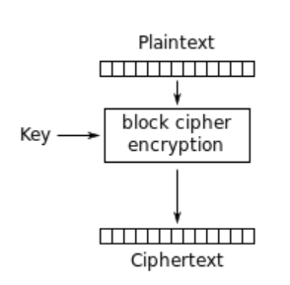
What is AES?
Published by NIST
Replacement of DES
Block size -128-bits
Uses key size 128,192,and 256-bits

Slide 4
AES Features
Same key is used for both encryption and decryption
Plaintext and cipher text are of same size
Secure
Easy to implement

Slide 5
AES vs DES
DES uses much smaller key than AES
DES is breakable
DES small block size
Comparison
 | AES | DES
Block size | 128-bits | 64-bits
Key size | 128, 192, and 256-bit | 56-bits
Rounds | 10,12, and 14 | 16

Slide 6
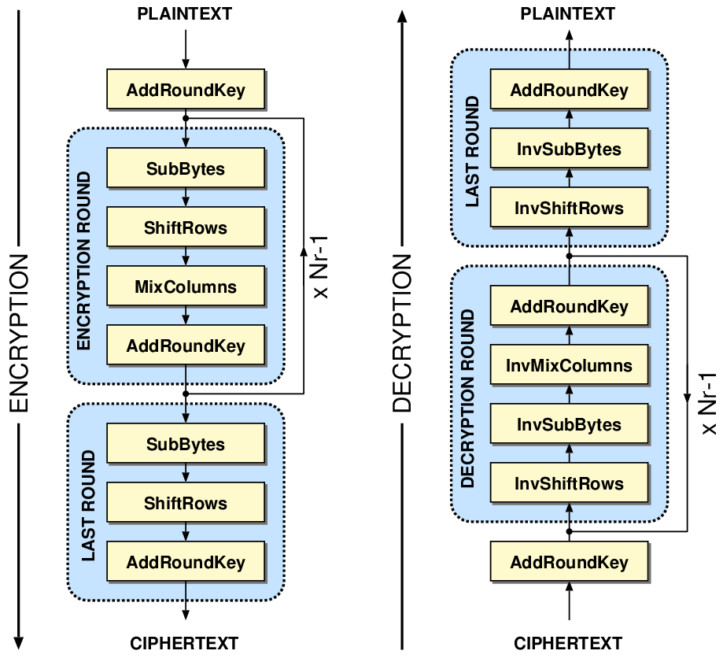
AES structure
Encryption and Decryption

Slide 7
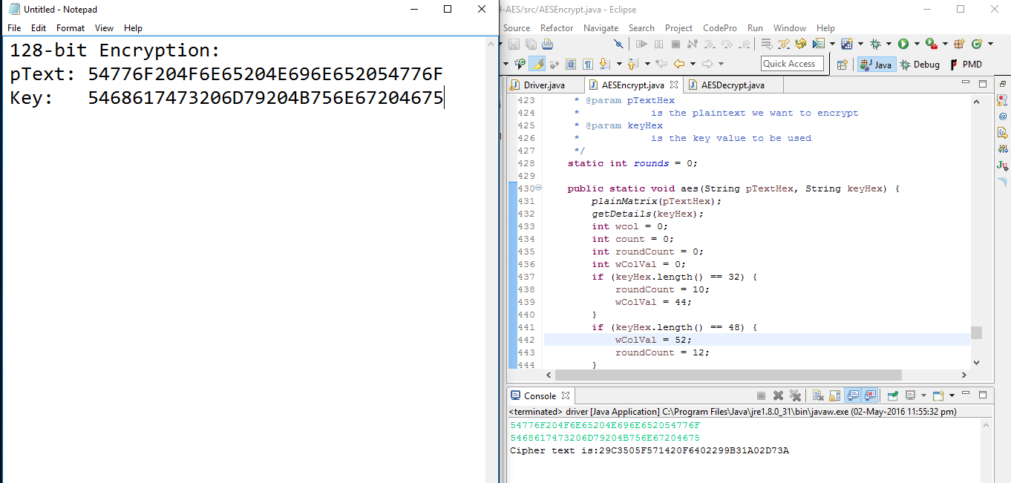
Project Screenshots

Slide 8
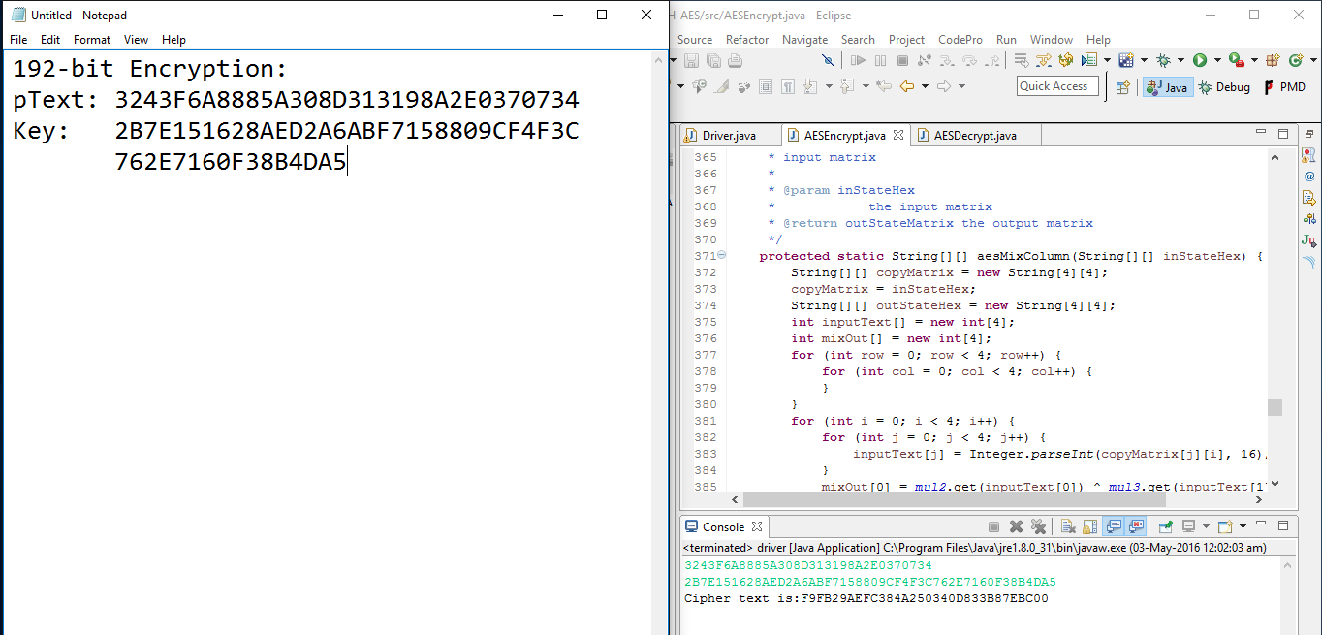

Slide 9
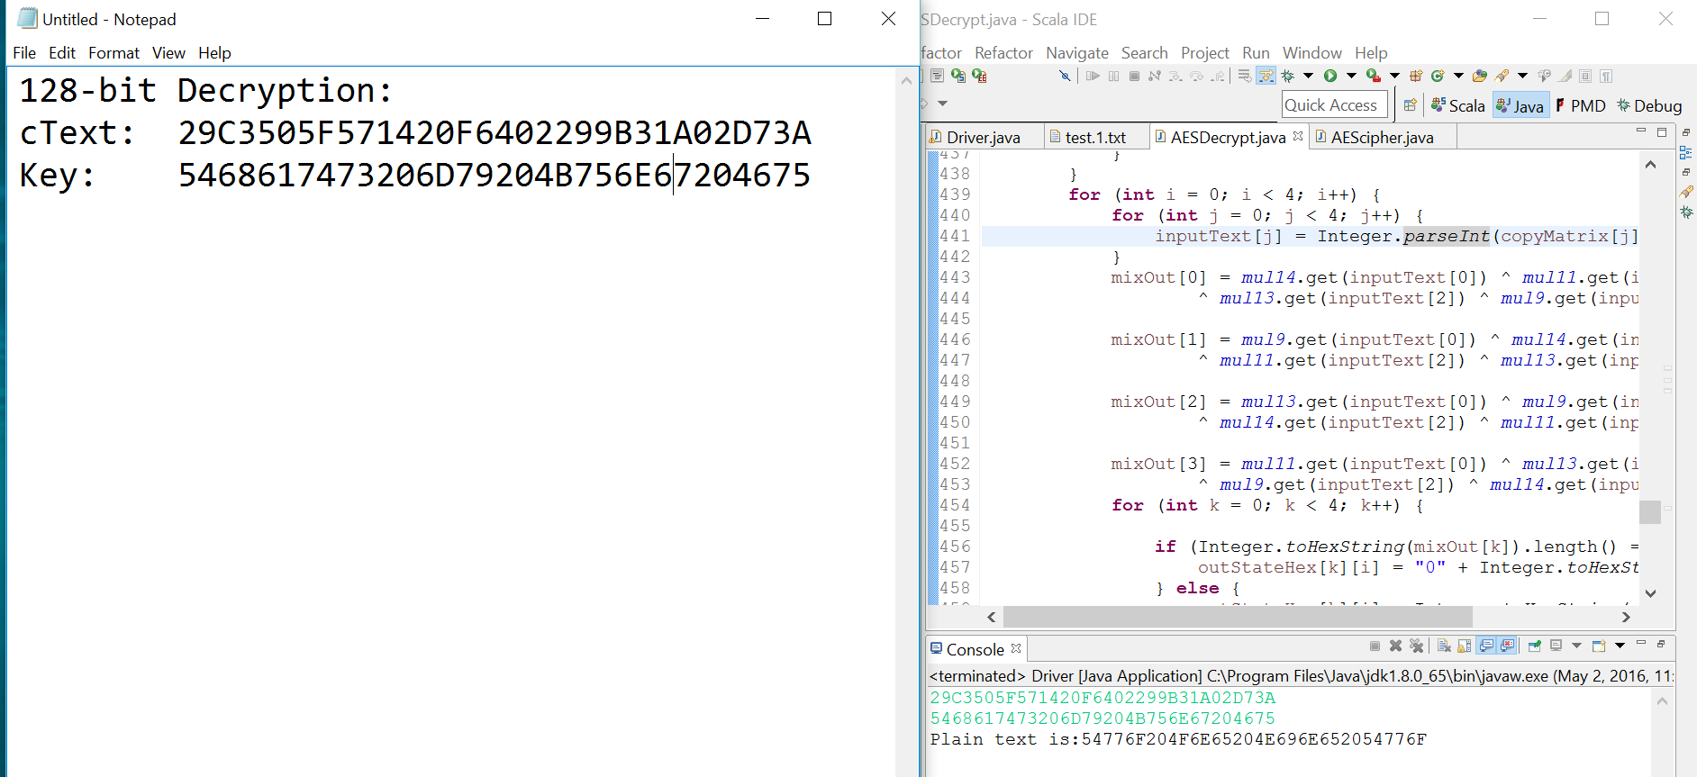

Slide 10
Padding Strategy
It is used in block cipher to make the length of the plain text(p) be an exact multiple of block size.
First determine the number of the padding bytes required.
It should satisfy 1<=n<=b and n+l(p) is the multiple of block size(b).

Slide 11
Authentication strategy
SHA-3
Replacement of SHA2
HMAC
Message itself is hashed
The result is hashed using key
h(K ^ a || h(K ^ b || m))

Slide 12
Conclusion
Easy to implement in both software and hardware
Simple design
Iterative.

Slide 13


